Slide 1


WELCOME TO THE
EVENING OF EXCELLENCE
Honoring the Top 5% of the Graduating Class at
Stevens High School and Central High School
and other Special Recognition Awards

Slide 2
WELCOME
Sharon Lee
Rapid City Public School Foundation Founder

Slide 3
TEACHER OF THE YEAR
Ross Hunter
Southwest Middle School

Slide 4
PRESENTATION OF STUDENTS OF DISTINCTION
Katy Urban and Michael Birkeland
Rapid City Board of Education and
Rapid City Public School Foundation Board Members

Slide 5
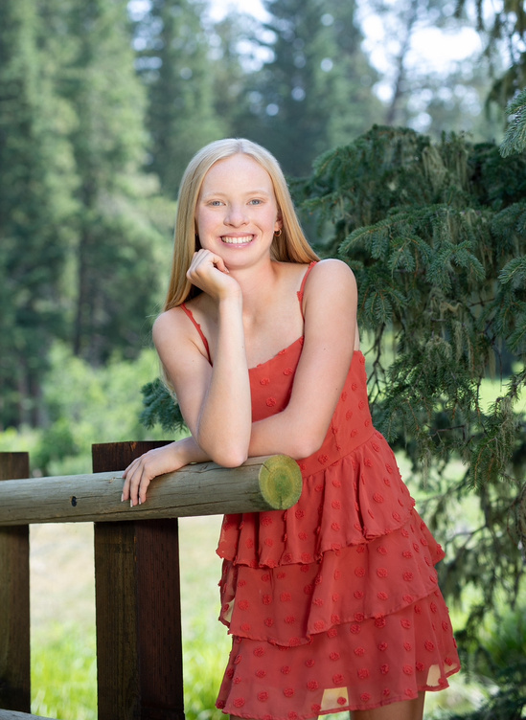

STUDENT OF DISTINCTION
Lauren Knapp
Stevens High School
Honoring:
Adam Dannenbring

Slide 6
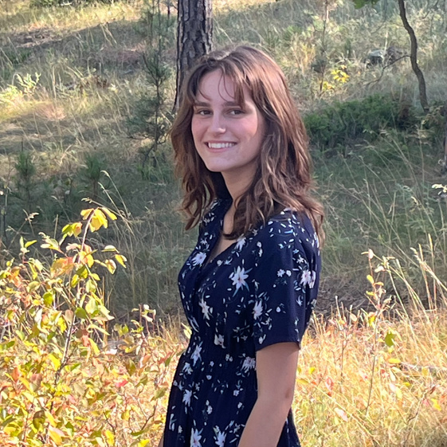
STUDENT OF DISTINCTION
Julia Mitchell
Stevens High School
Honoring:
Alicia Coyne

Slide 7
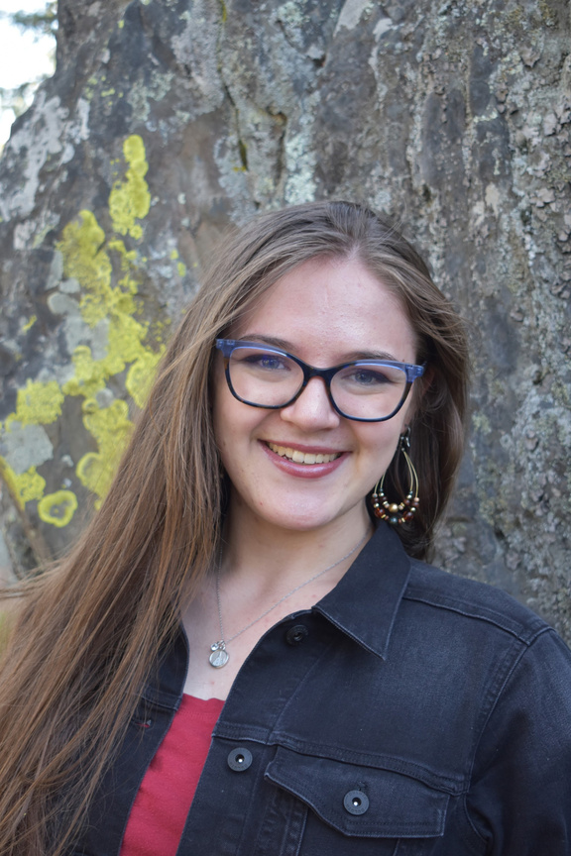
STUDENT OF DISTINCTION
Miriam Ostler
Stevens High School
Honoring:
Alicia Coyne

Slide 8

STUDENT OF DISTINCTION
Tianna Boerke
Central High School
Honoring:
Amanda Caron

Slide 9
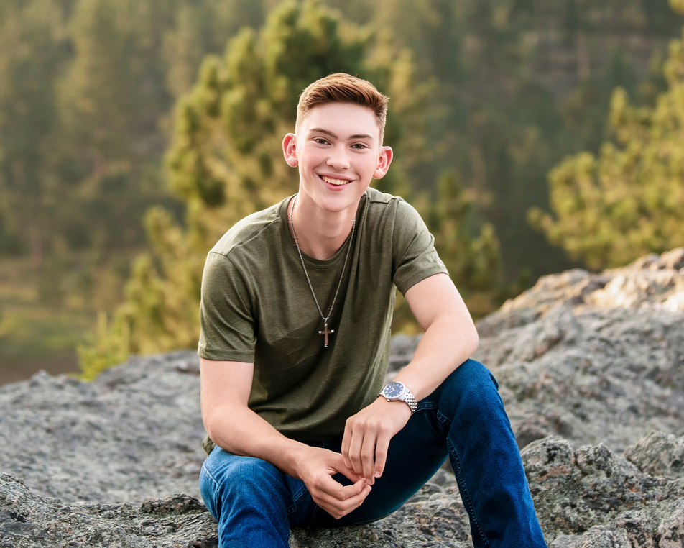
STUDENT OF DISTINCTION
Owen Darger
Central High School
Honoring:
Andrew Belsaas

Slide 10
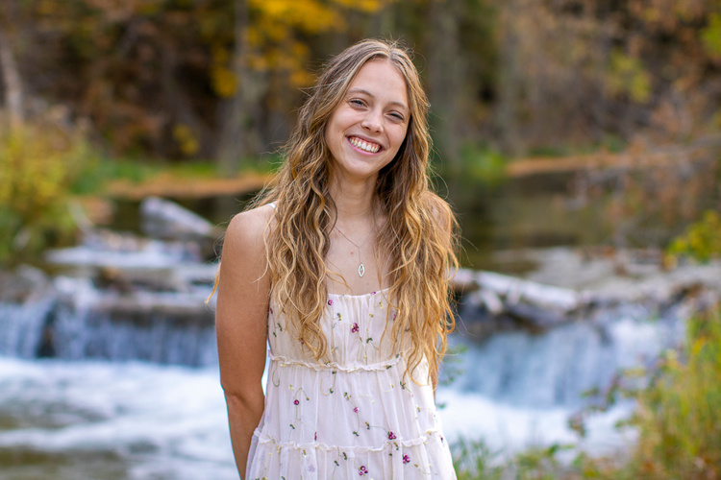
STUDENT OF DISTINCTION
Elsa Grimsrud
Central High School
Honoring:
Andrew Martin

Slide 11

STUDENT OF DISTINCTION
Kelty Silbernagel
Central High School
Honoring:
Brandi Christoffer

Slide 12
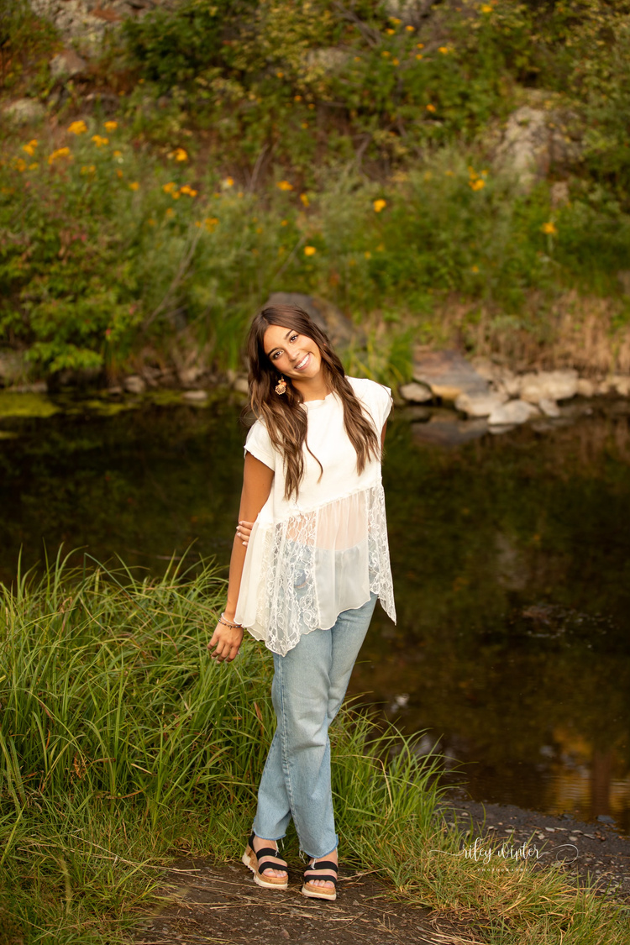
STUDENT OF DISTINCTION
Elise Nopola
Central High School
Honoring:
Brendon Sato

Slide 13

STUDENT OF DISTINCTION
Olivia Pozorski
Central High School
Honoring:
Brendon Sato

Slide 14
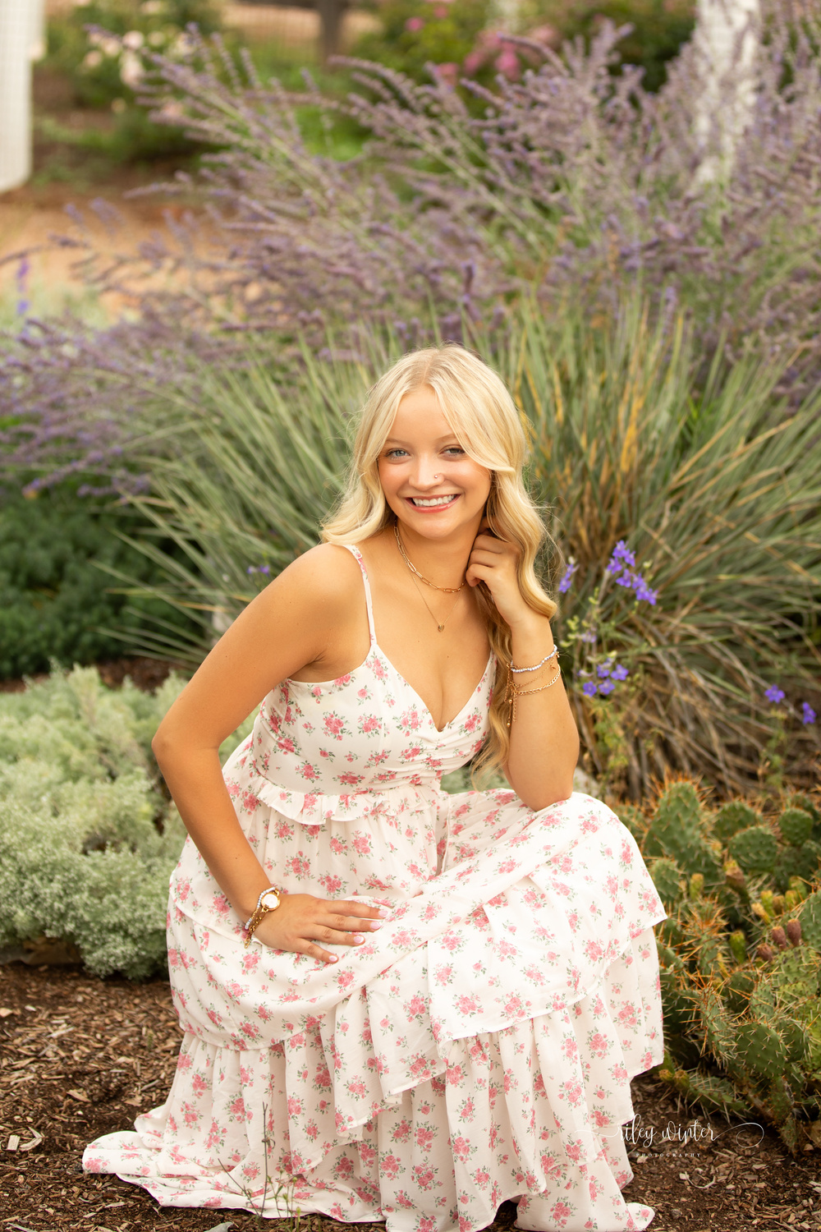
STUDENT OF DISTINCTION
Hannah Lapp
Central High School
Honoring:
Brody Griffin

Slide 15
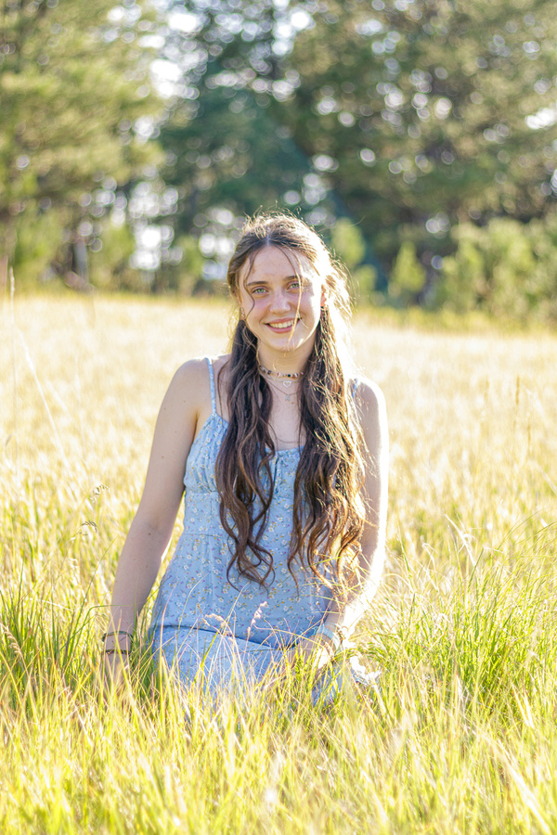
STUDENT OF DISTINCTION
Aidon Griffin
Central High School
Honoring:
Callum Dewar

Slide 16
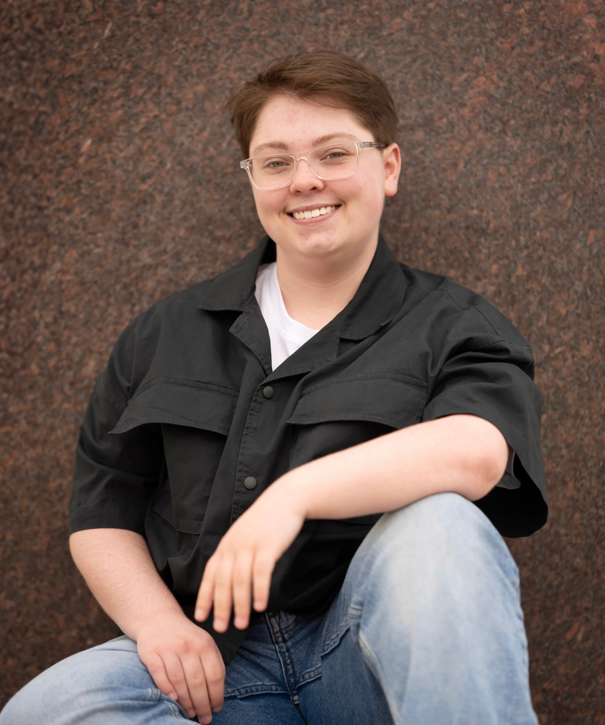
STUDENT OF DISTINCTION
Jack Monroe
Central High School
Honoring:
Carol Knowles

Slide 17
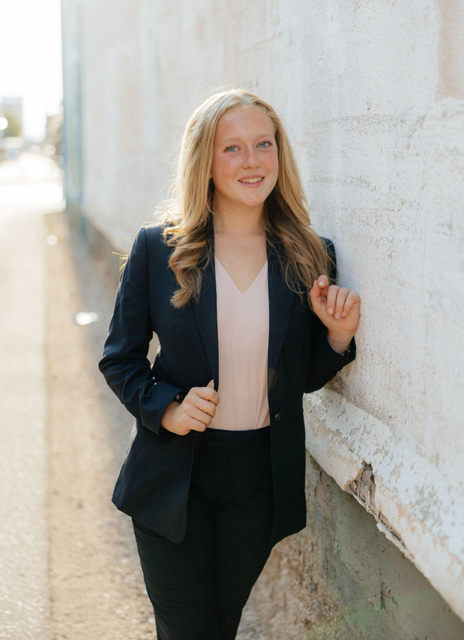
STUDENT OF DISTINCTION
Olivia Boerger
Stevens High School
Honoring:
Carrie Huber

Slide 18
STUDENT OF DISTINCTION
Sydney Miller
Stevens High School
Honoring:
Carrie Huber

Slide 19

STUDENT OF DISTINCTION
Owen Coody
Stevens High School
Honoring:
Dr. Andrew Smith

Slide 20

STUDENT OF DISTINCTION
Katelinn Ohrtman
Stevens High School
Honoring:
Dr. Andrew Smith

Slide 21
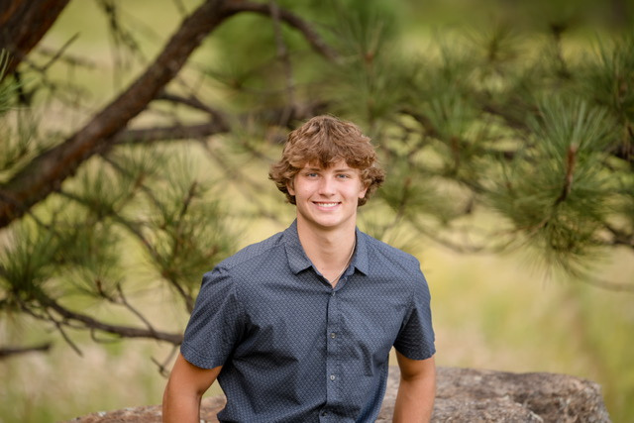
STUDENT OF DISTINCTION
Mason McGregor
Central High School
Honoring:
Dr. Robert Riggs

Slide 22
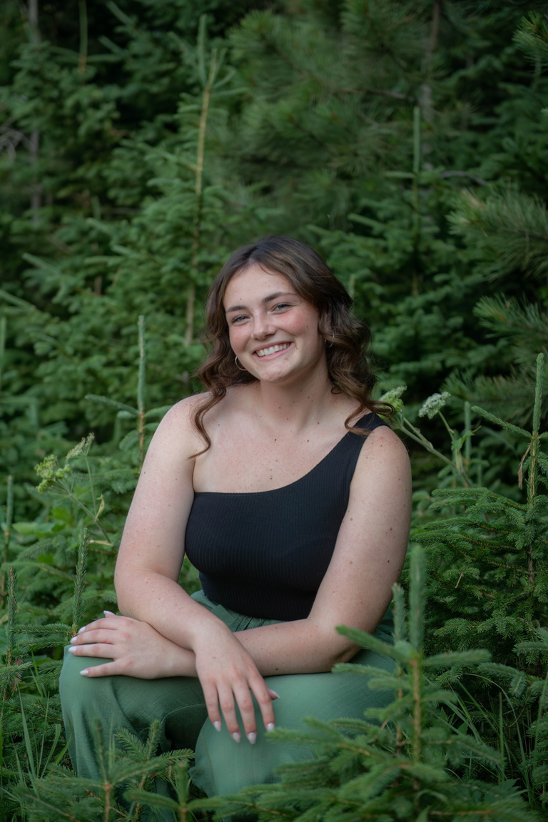
STUDENT OF DISTINCTION
Kelsi Kroeger
Central High School
Honoring:
Emily McGruther

Slide 23
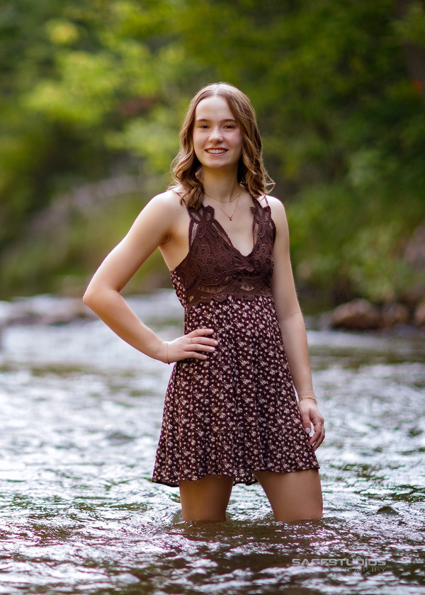
STUDENT OF DISTINCTION
Kaylie Tupper
Central High School
Honoring:
Emily Pflaum

Slide 24
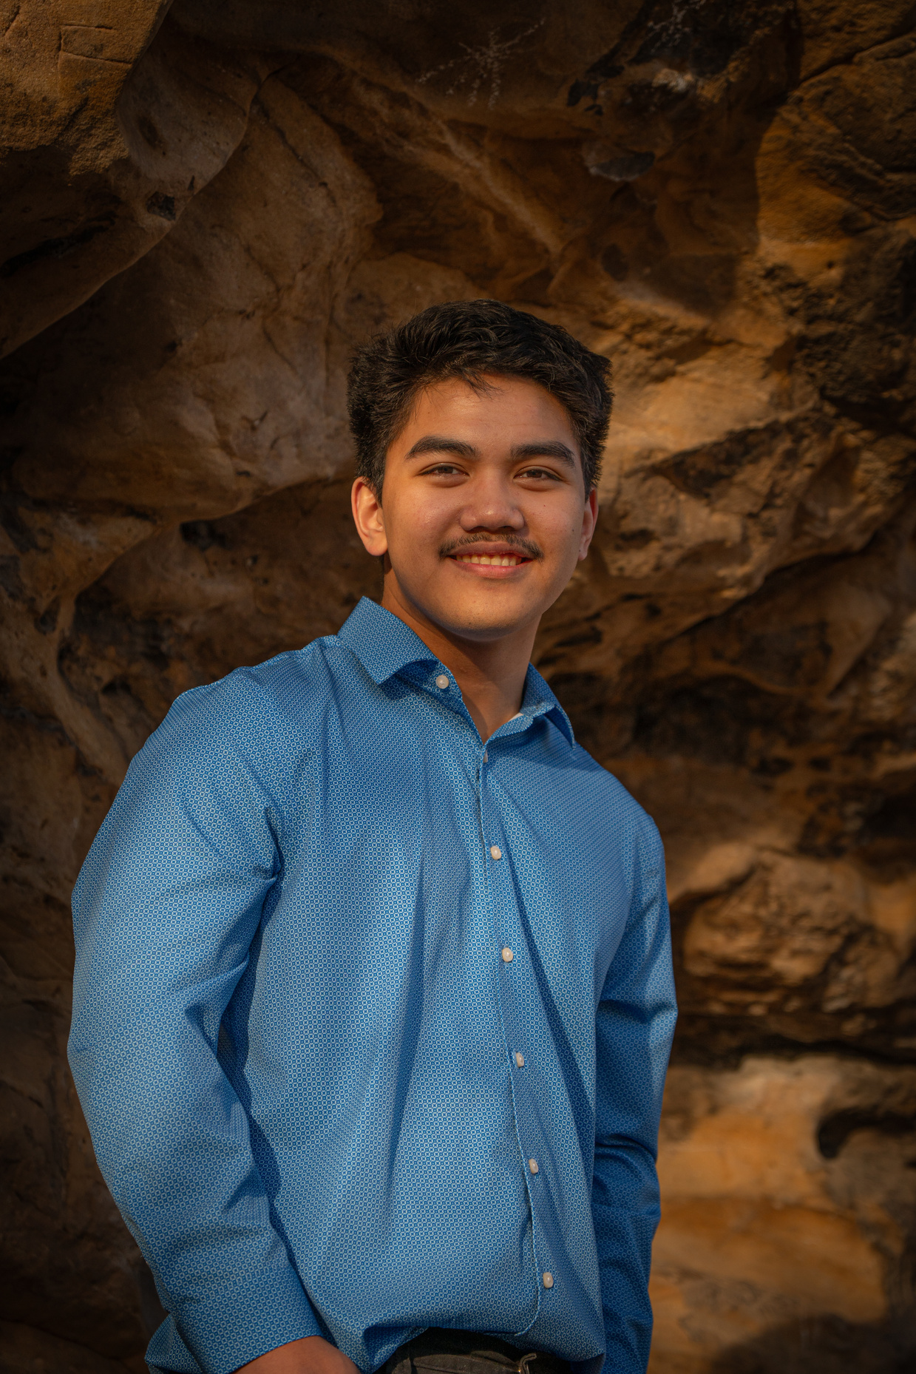
STUDENT OF DISTINCTION
Ephraim Manasseh B. Roque
Stevens High School
Honoring:
Erik Iverson

Slide 25
STUDENT OF DISTINCTION
Isabela Griffin
Central High School
Honoring:
Geoffrey Sheehy

Slide 26
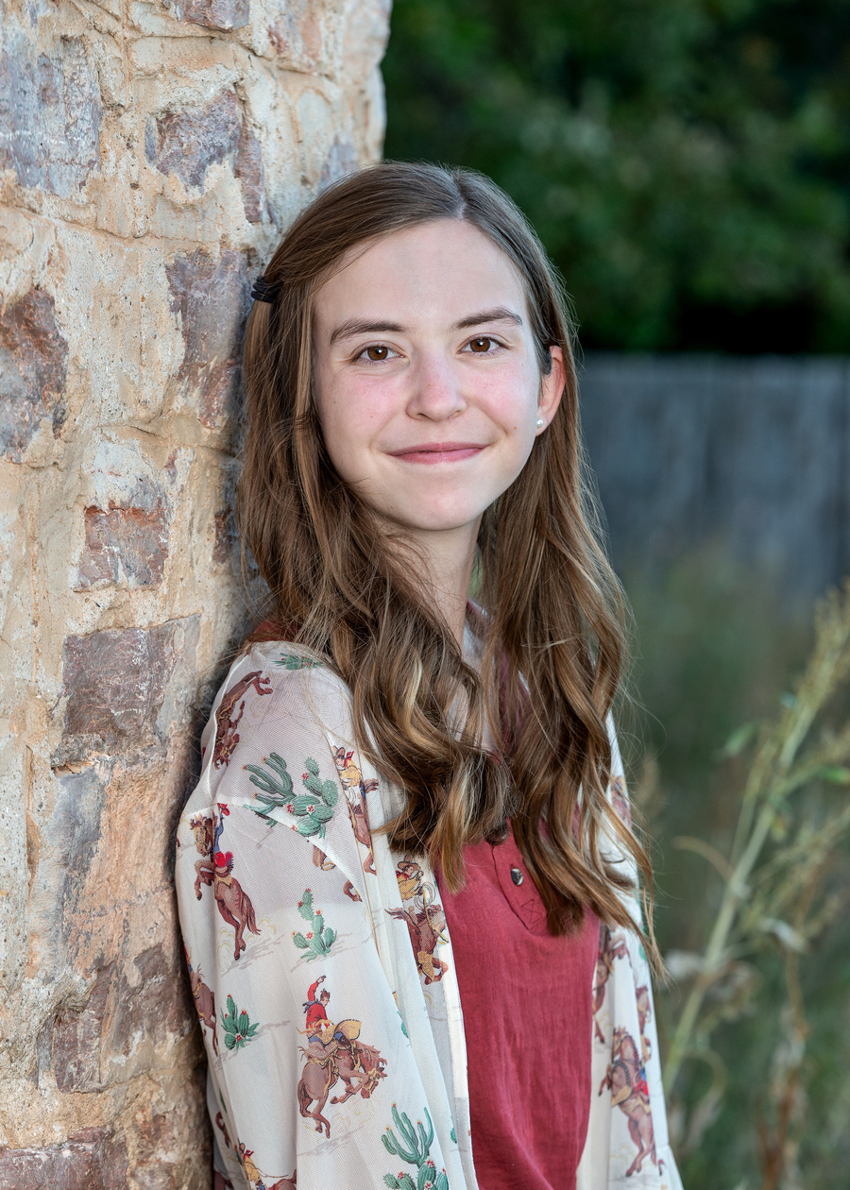
STUDENT OF DISTINCTION
Rylie Sleep
Stevens High School
Honoring:
George Dragoo

Slide 27
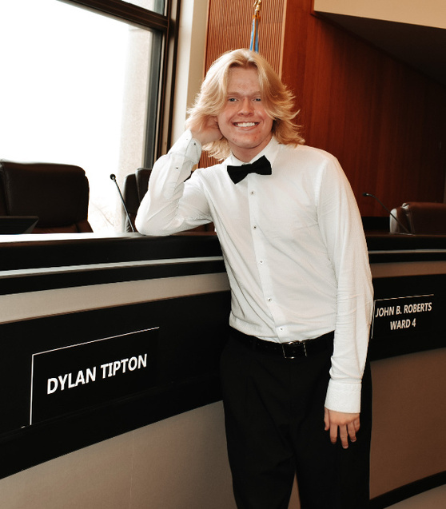
STUDENT OF DISTINCTION
Dylan Tipton
Stevens High School
Honoring:
Janelle Farris

Slide 28

STUDENT OF DISTINCTION
Addison Hock
Stevens High School
Honoring:
Jen Roark

Slide 29
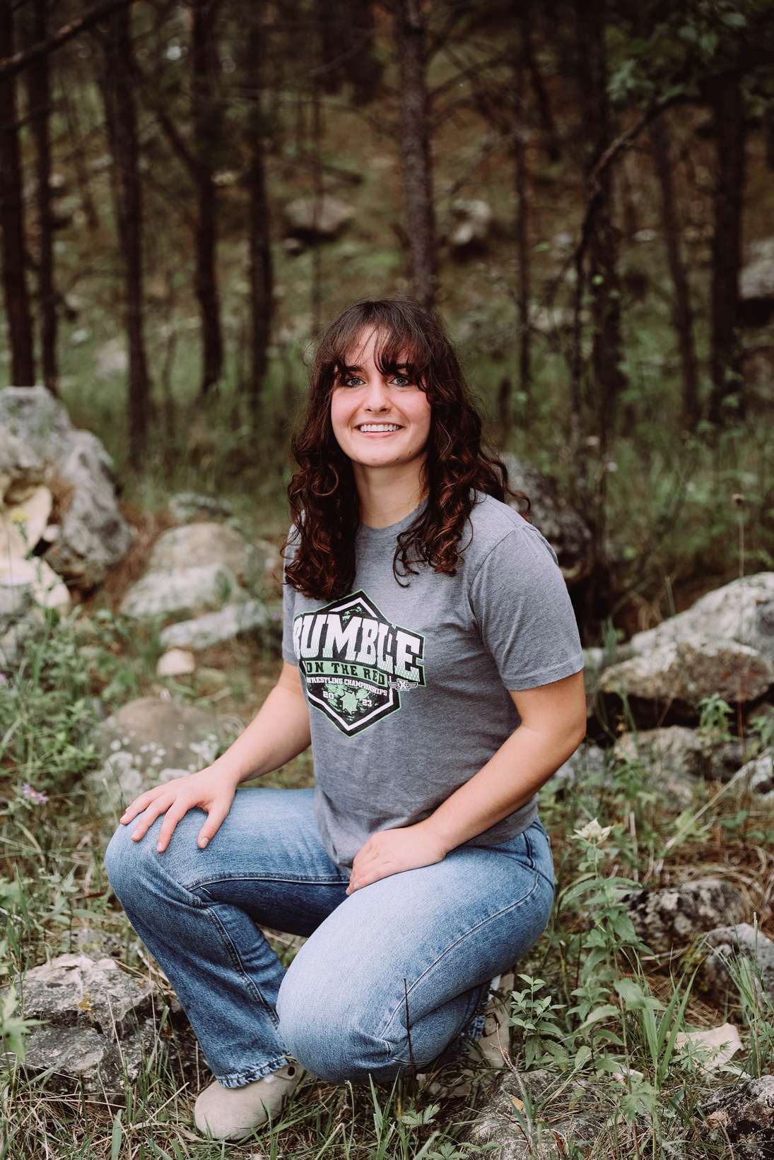
STUDENT OF DISTINCTION
Marieda Kalahar
Stevens High School
Honoring:
Jennifer Haar

Slide 30
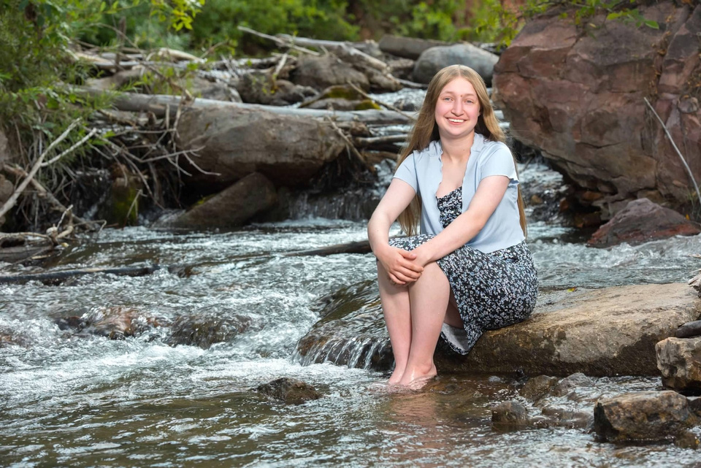
STUDENT OF DISTINCTION
Amelia Schaefbauer
Central High School
Honoring:
Jimmy Reed

Slide 31
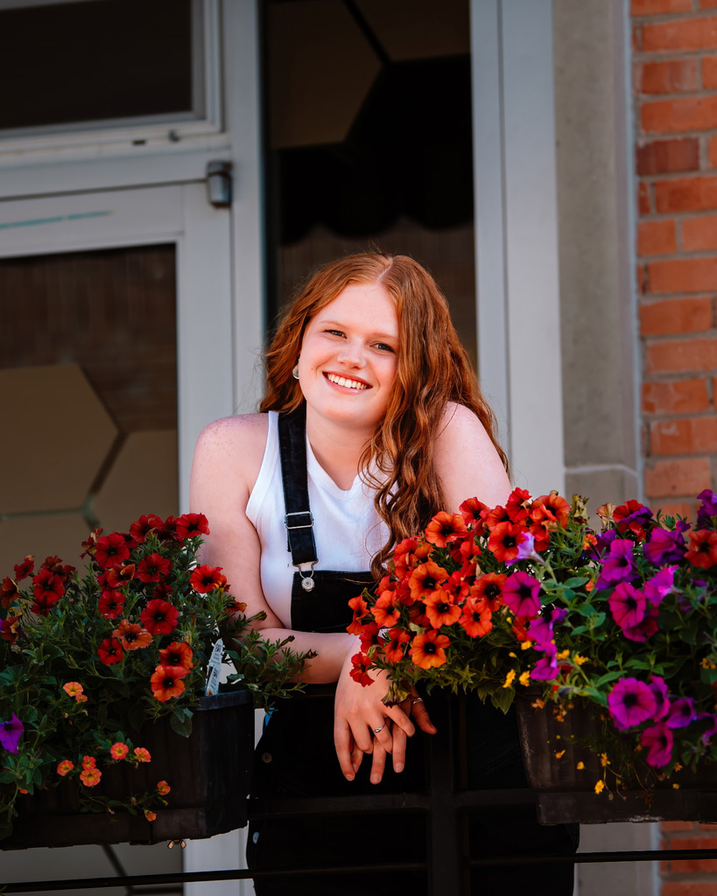
STUDENT OF DISTINCTION
Claire Comes
Central High School
Honoring:
Joey Lore

Slide 32
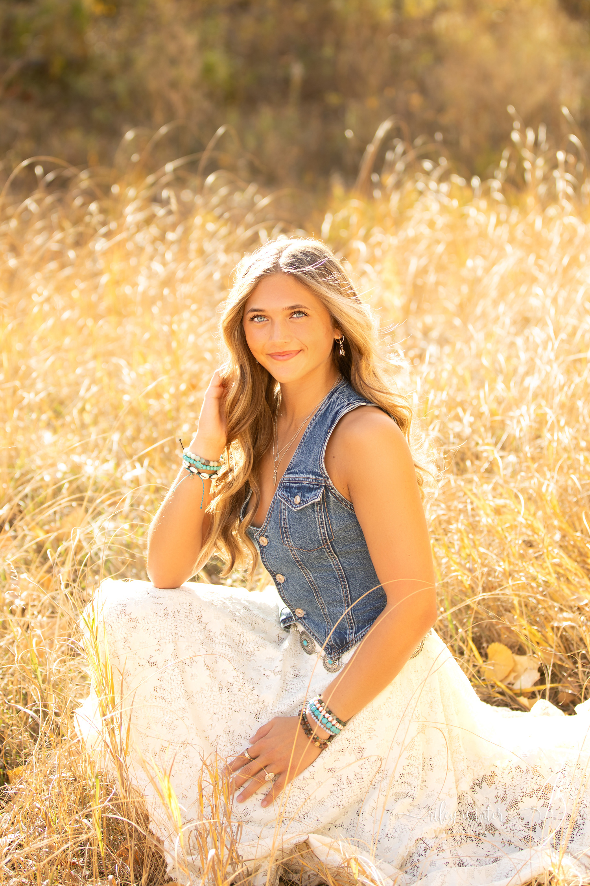
STUDENT OF DISTINCTION
Emma Dressler
Stevens High School
Honoring:
Lisa Evans

Slide 33
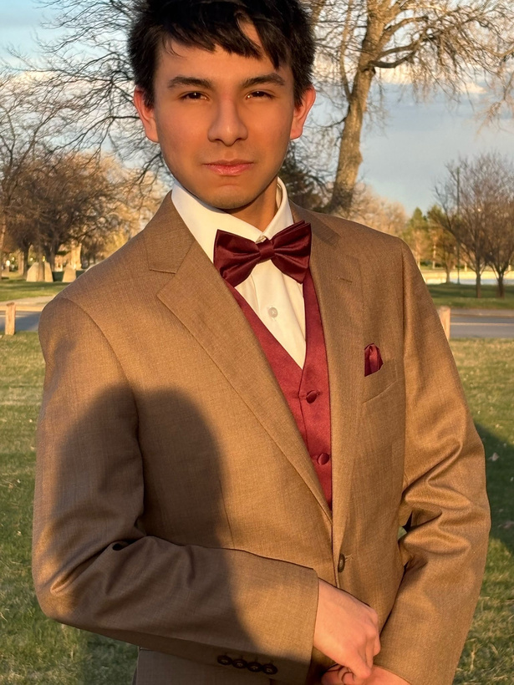
STUDENT OF DISTINCTION
Joshua Alexander Hernandez- Campos
Central High School
Honoring:
Melissa Hadorn

Slide 34
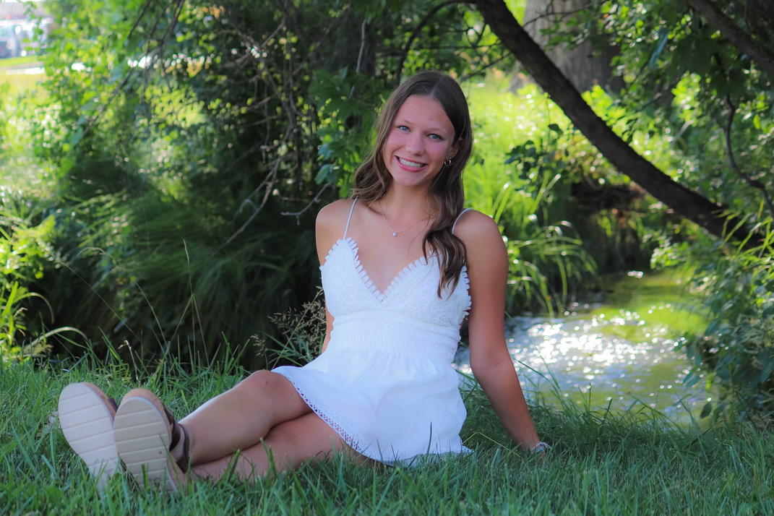
STUDENT OF DISTINCTION
Opal Nelson
Stevens High School
Honoring:
Sean Bradley

Slide 35
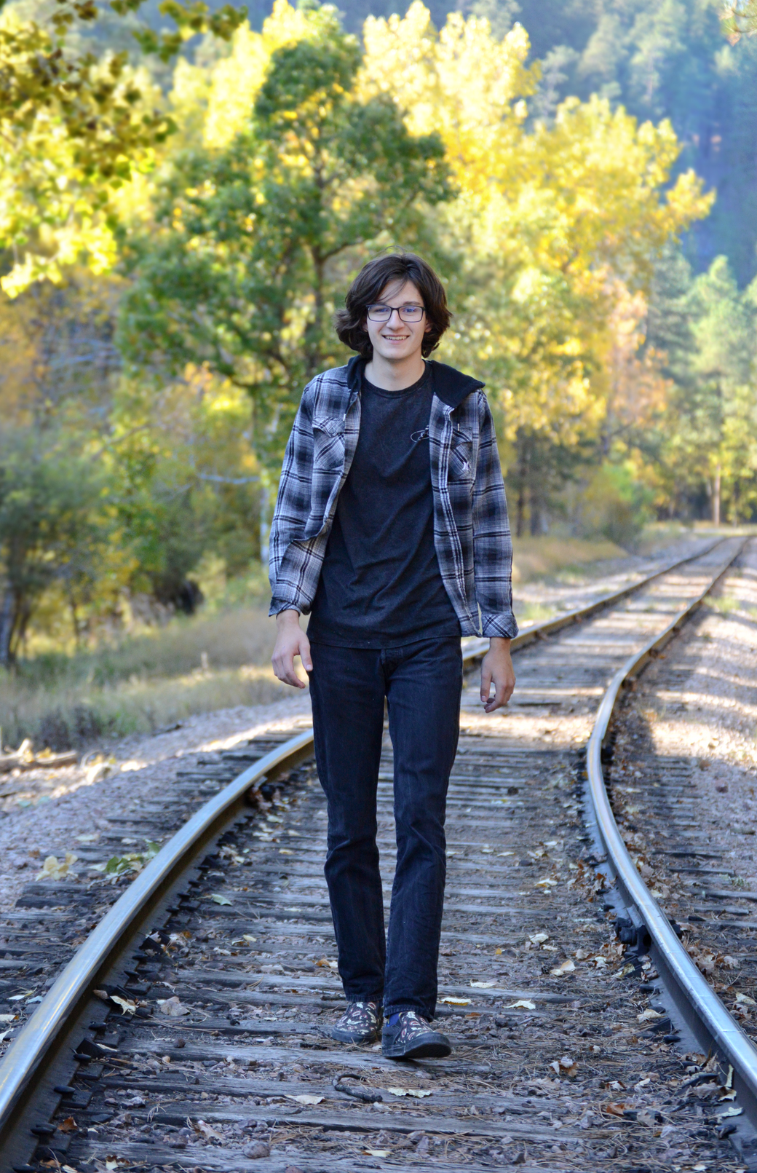
STUDENT OF DISTINCTION
Braiden Blenner
Stevens High School
Honoring:
Seth Keene

Slide 36
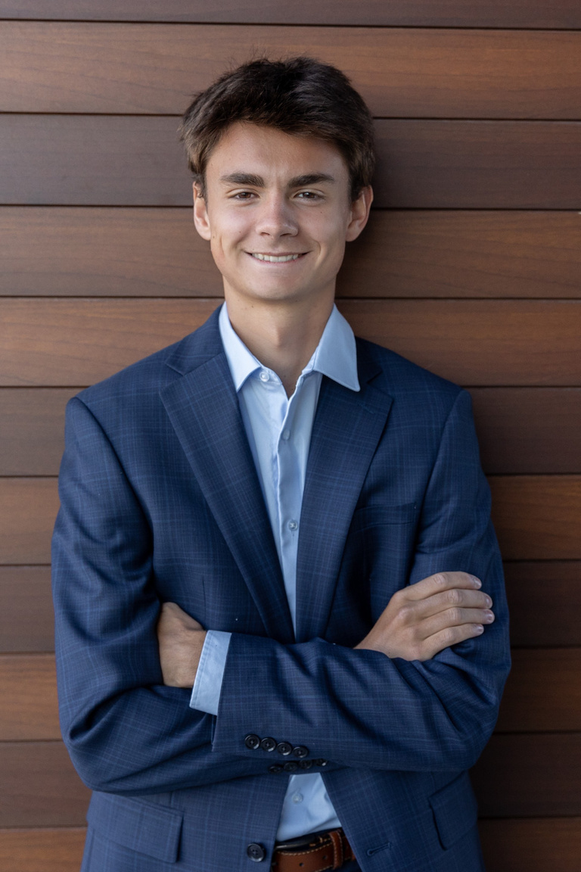
STUDENT OF DISTINCTION
Miles Brekhus
Stevens High School
Honoring:
Seth Keene

Slide 37

STUDENT OF DISTINCTION
Emerson Hofer
Stevens High School
Honoring:
Shannon Bren

Slide 38
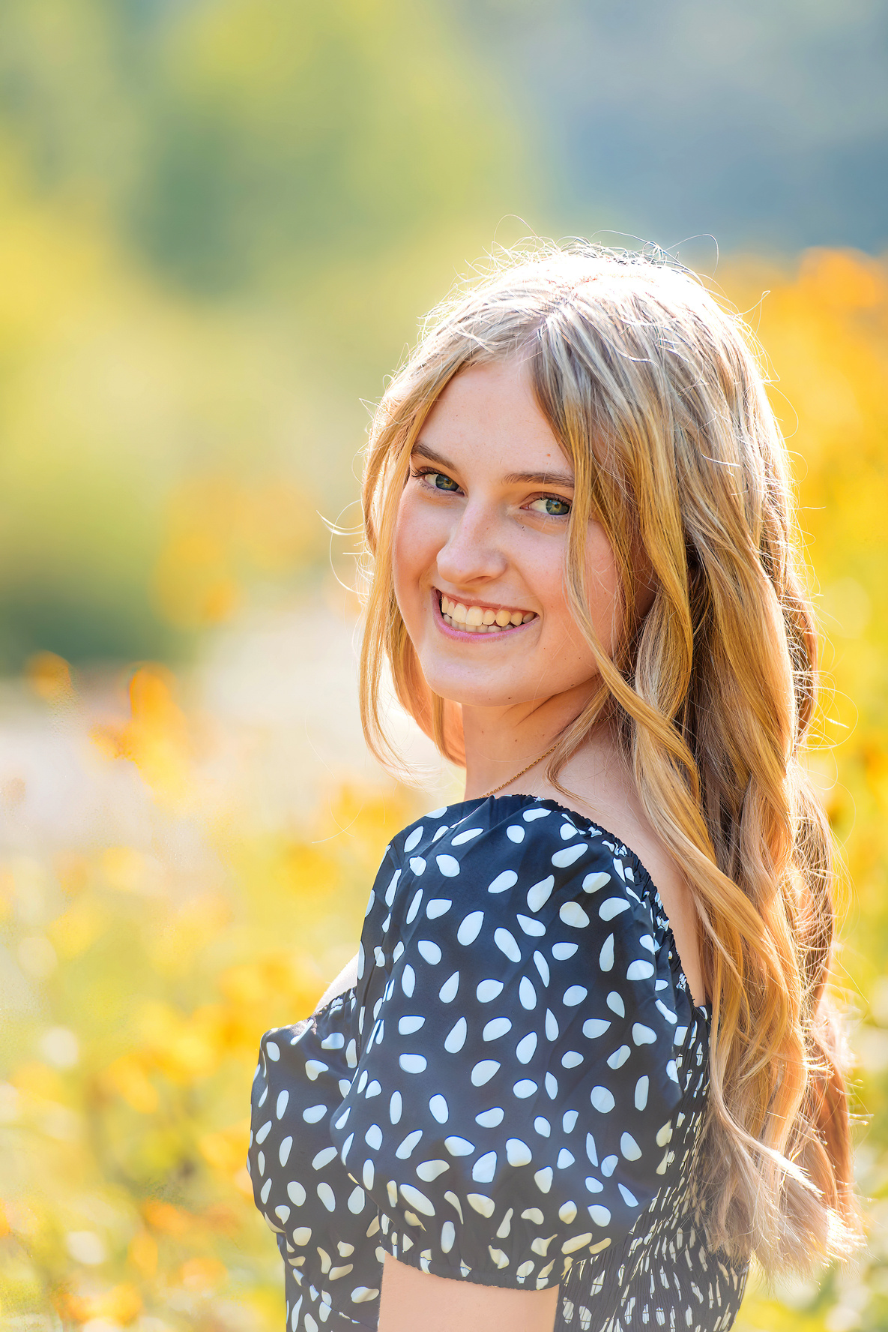
STUDENT OF DISTINCTION
Olivia Miller
Stevens High School
Honoring:
Shannon Bren

Slide 39
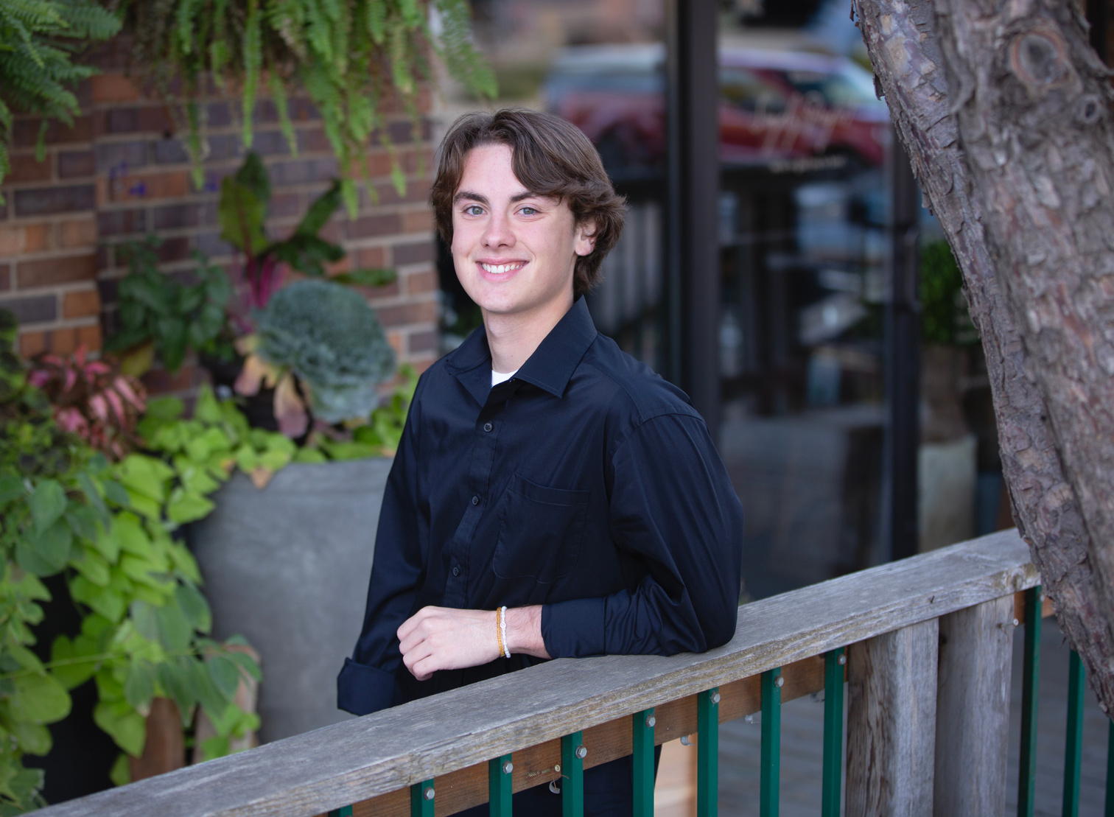
STUDENT OF DISTINCTION
James Rus
Stevens High School
Honoring:
Shannon Bren

Slide 40
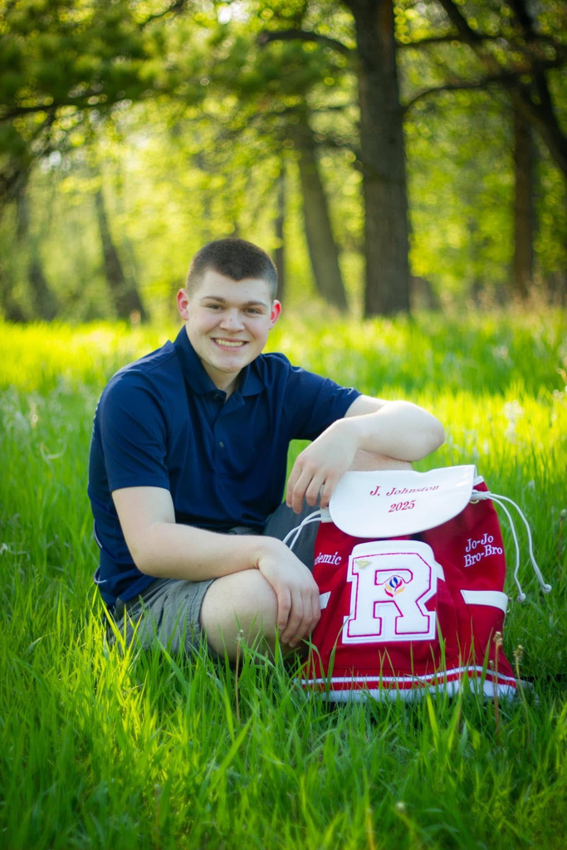
STUDENT OF DISTINCTION
Joseph Johnston
Central High School
Honoring:
Todd Johnson

Slide 41
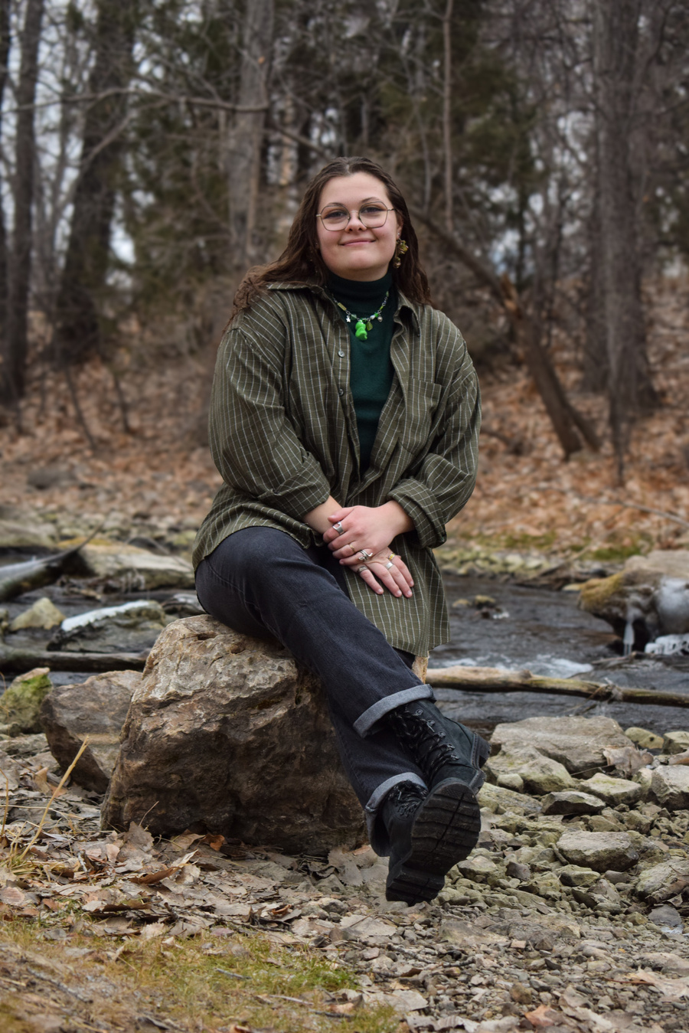
STUDENT OF DISTINCTION
Bryn Marietta
Stevens High School
Honoring:
Tyler Olson

Slide 42
STUDENT OF DISTINCTION
Kylie Meier
Stevens High School

Slide 43
SPECIAL RECOGNITION AWARDS
Lara Roetzel and Matt McCormick
Rapid City Public School Foundation Board Members

Slide 44

VOLUNTEER OF EXCELLENCE
Miriam Ostler
Stevens High School
Honoring:
Alicia English

Slide 45
VOLUNTEER OF EXCELLENCE
Amelia Schaefbauer
Central High School
Honoring:
Audra Franke

Slide 46

CTE PATHWAY TO EXCELLENCE
Patty Timmons
Stevens High School
Honoring:
Genetie Hendrix

Slide 47
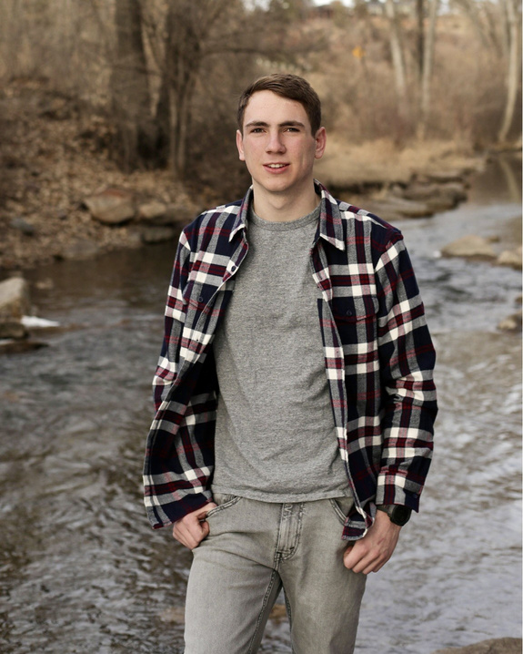
CTE PATHWAY TO EXCELLENCE
Tyler Barker
Central High School
Honoring:
First Sergeant Ryan Wheele

Slide 48
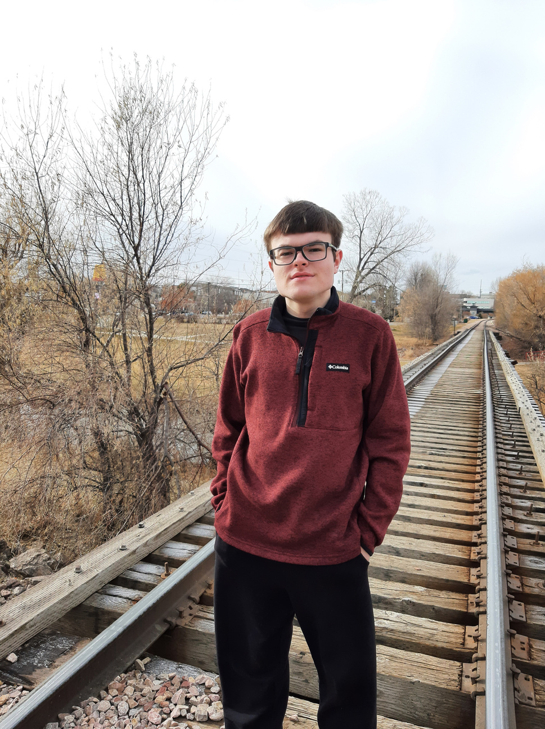
STUDENT OF DISTINCTION
Joshua Burckhard
Stevens High School
Honoring:
Michelle Chuplis
Raider Spirit Award

Slide 49
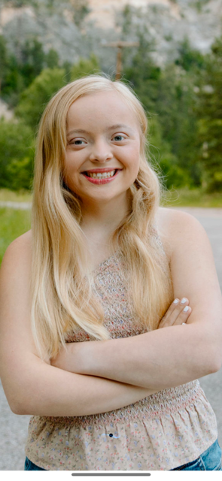
STUDENT OF DISTINCTION
Grayce Holzer
Stevens High School
Honoring:
Kelsey Jones
Cobbler Spirit Award

Slide 50
CLOSING REMARKS
Sara Hornick
Rapid City Public School Foundation
Executive Director

Slide 51
Congratulations
GRADUATES

